Slide 1

Support Vector Regression (SVR)

Slide 2
What is SVR?
Support Vector Regression (SVR) is a machine learning algorithm based on Support Vector Machines (SVM), adapted for regression tasks. It predicts continuous values by finding a hyperplane that fits the data within a margin of tolerance (epsilon-tube). Unlike classification SVM, SVR focuses on regression while being robust to outliers.

Slide 3
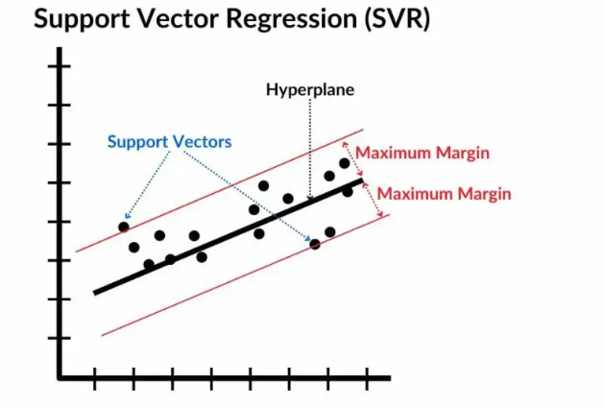
Key Idea:
SVR tries to fit as many data points as possible within an epsilon-insensitive tube around the regression line, ignoring small errors inside the tube and penalizing larger deviations.
Visual Suggestion: Insert a diagram showing data points, the regression line, and the epsilon-tube (band) with support vectors marked.
fig2

Slide 4
How SVR Works
Kernel Selection: SVR uses a kernel function to map the input data into a higher-dimensional feature space where it becomes easier to find a hyperplane that separates the data. Common kernel functions include linear, polynomial, radial basis function (RBF), and sigmoid.
Objective Function: SVR aims to minimize the error between the predicted values and the actual target values while also maximizing the margin. It does this by minimizing the following objective function

Slide 5
Steps in Training SVR:
Choose a kernel (e.g., linear, RBF) to handle non-linearity.
Define epsilon (tube width) – errors within epsilon are ignored.
Use regularization parameter C to control trade-off between flatness and error.
Optimize to find the best hyperplane.

Slide 6
Advantages:
Handles non-linear data well.
Robust to noise/outliers due to epsilon-insensitivity.
Sparse model (uses only support vectors).
Disadvantages:
Computationally intensive for large datasets.
Sensitive to parameter tuning (epsilon, C, kernel params).
Visual Suggestion: Flowchart of SVR training process.

Slide 7
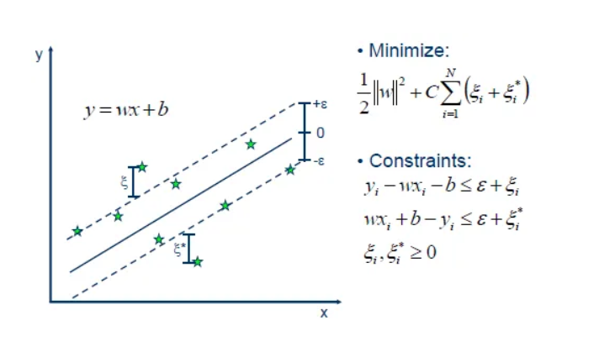
SVR Equations
margin: The margin ε determines the width of the tube around the hyperplane within which no penalty is incurred. Data points within this tube are considered to be correctly predicted and do not contribute to the error.
Loss Function: SVR typically uses the epsilon-insensitive loss function, which ignores errors smaller than ε. This loss function helps in making the model less sensitive to outliers.
fig1
Where: www is the weight vector, b is bias, ϵ\epsilonϵ is the tube margin ξi​,ξi∗​ are slack variables for deviations, C is regularization.

Slide 8
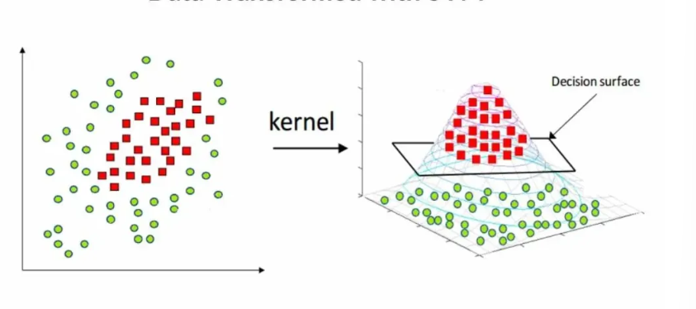
Kernel Functions
SVR employs kernel functions to map input data into high-dimensional feature spaces where linear relationships may exist. Popular kernel functions include Linear, Polynomial, Gaussian Radial Basis Function (RBF), and Sigmoid, each suitable for different data types and relationships.
fig3

Slide 9
Key Parameters in SVR
Epsilon (ε): Defines the width of the insensitive tube. Larger ε = more tolerance to errors, simpler model.
C (Regularization): Penalty for errors outside the tube. High C = less tolerance (overfitting risk), low C = more generalization
Kernel Types:

Slide 10
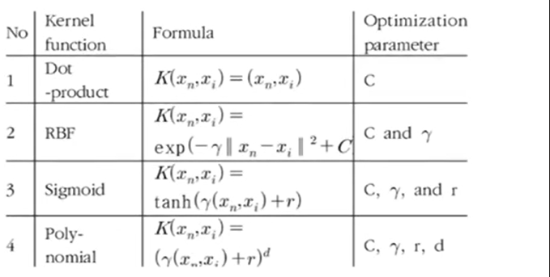
Kernel Functions
Dot Product: Represented as with C as the optimization parameter. This is a simple inner product of two vectors.
RBF (Radial Basis Function): Given by it uses C and γ \gamma γ as parameters. This kernel is effective for non-linear data.
Sigmoid: Defined as with parameters C , γ \gamma γ, and r . It mimics neural network activation functions.
Polynomial: Expressed as, it includes C , γ \gamma γ, r , and d (degree) as parameters, suitable for polynomial relationships.
fig4

Slide 11
Tips and Tricks for Support Vector Regression (SVR)
support Vector Regression (SVR) offers flexibility and power in modelling complex relationships between variables. To harness its full potential and achieve optimal performance, consider the following tips and tricks:
Choose the Right Kernel Function
Experiment with different kernel functions (e.g., linear, polynomial, RBF) to capture diverse relationships in your data. RBF kernel is often a good starting point due to its flexibility in capturing nonlinear patterns.
ptimise Hyperparameters
To improve model performance, Fine-tune hyperparameters such as epsilon (ε), regularisation parameter (C), and kernel parameters. Utilise techniques like grid or random search to explore the hyperparameter space efficiently.
Feature Scaling
Ensure consistent scaling of features to prevent bias towards features with larger scales. Standardise or normalise features using techniques like StandardScaler or MinMaxScaler to achieve better convergence and performance

Slide 12
Handle Outliers
SVR is sensitive to outliers, which can significantly affect model fitting. Consider outlier detection techniques or robust regression methods to mitigate the impact of outliers on model performance.
Cross-Validation
Use techniques such as k-fold cross-validation to robustly assess the model’s performance. Cross-validation helps evaluate the model’s generalisation ability and identifies potential overfitting or underfitting issues.
Regularisation
Adjust the regularisation parameter (C) to control the model complexity and training error trade-offs. Higher values of C result in a more complex model that may overfit the training data, while lower values encourage a simpler model with potentially higher bias.
regularize Kernel Functions
Adjust kernel parameters (e.g., gamma for the RBF kernel) to control the smoothness of decision boundaries and prevent overfitting. Regularising kernel functions can enhance model generalisation and avoid memorising noise in the data.

Slide 13
When to Use SVR
Use Cases:
When data has non-linear relationships (e.g., stock prices, weather forecasting).
Robust regression needed for noisy data or outliers (e.g., sensor data, financial modeling).
Small to medium datasets (scales poorly with large data due to O(n^2) complexity).
When interpretability via support vectors is useful (e.g., identifying key data points).
When NOT to Use: Very large datasets (use neural networks instead).
Strictly linear problems (Linear Regression is simpler).
Need for probabilistic outputs (use Gaussian Processes).

Slide 14
Differences Between Linear Regression (LR) and SVR
Aspect | Linear Regression (LR) | Support Vector Regression (SVR)
Goal | Minimize sum of squared errors (MSE). | Minimize errors outside epsilon-tube; ignore small errors.
Model Type | Parametric, assumes linear relationship. | Can be non-parametric with kernels for non-linearity.
Loss Function | Squared loss: (y−y^)2 (y - \hat{y})^2 (y−y^​)2. | Epsilon-insensitive: $$ \max(0,
Handling Outliers | Sensitive; outliers heavily influence the line. | Robust; only support vectors matter, ignores minor deviations.
Complexity | Simple, fast training (O(n)). | More complex, slower (O(n^2 to n^3)); uses kernel trick.
Output | Best-fit line through all points. | Hyperplane with margin; sparse (only SVs used).
When to Choose | Linear data, large datasets, need simplicity/probability. | Non-linear/noisy data, robustness needed.
Equation Example | y^=w⋅x+b \hat{y} = w \cdot x + b y^​=w⋅x+b, minimize ∑(yi−yi^)2 \sum (y_i - \hat{y_i})^2 ∑(yi​−yi​^​)2. | See SVR equations above; includes C and ε.

Slide 15
Key Differences Explained
LR fits all data points equally; SVR focuses on boundary points (support vectors).
LR can overfit noise; SVR's epsilon makes it more generalizable.
SVR extends to non-linear via kernels; LR needs feature engineering for non-linearity.

Slide 16
References
https://dibyanshusharma16.medium.com/support-vector-regression-svr-4b9422e6765a
https://spotintelligence.com/2024/05/08/support-vector-regression-svr/
https://spotintelligence.com/2024/05/08/support-vector-regression-svr/
https://www.researchgate.net/figure/Kernel-functions-tested-for-LS-SVR-and-SVR-28_tbl4_354128673

